Slide 1

Overview of the LAVA Curvilinear Framework’s Viscous Overset Grid System Preprocessing and Connectivity Capabilities
James R. L. Koch
Jeff A. Housman, Brandon M. Lowe, David A. Craig Penner Chase P. Ashby, Jared C. Duensing
Computational Aerosciences Branch
NASA Ames Research Center
2026-10-21
2026 Overset Symposium

Slide 2
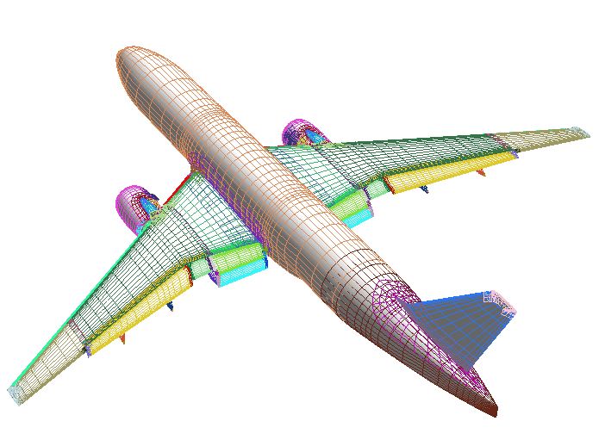
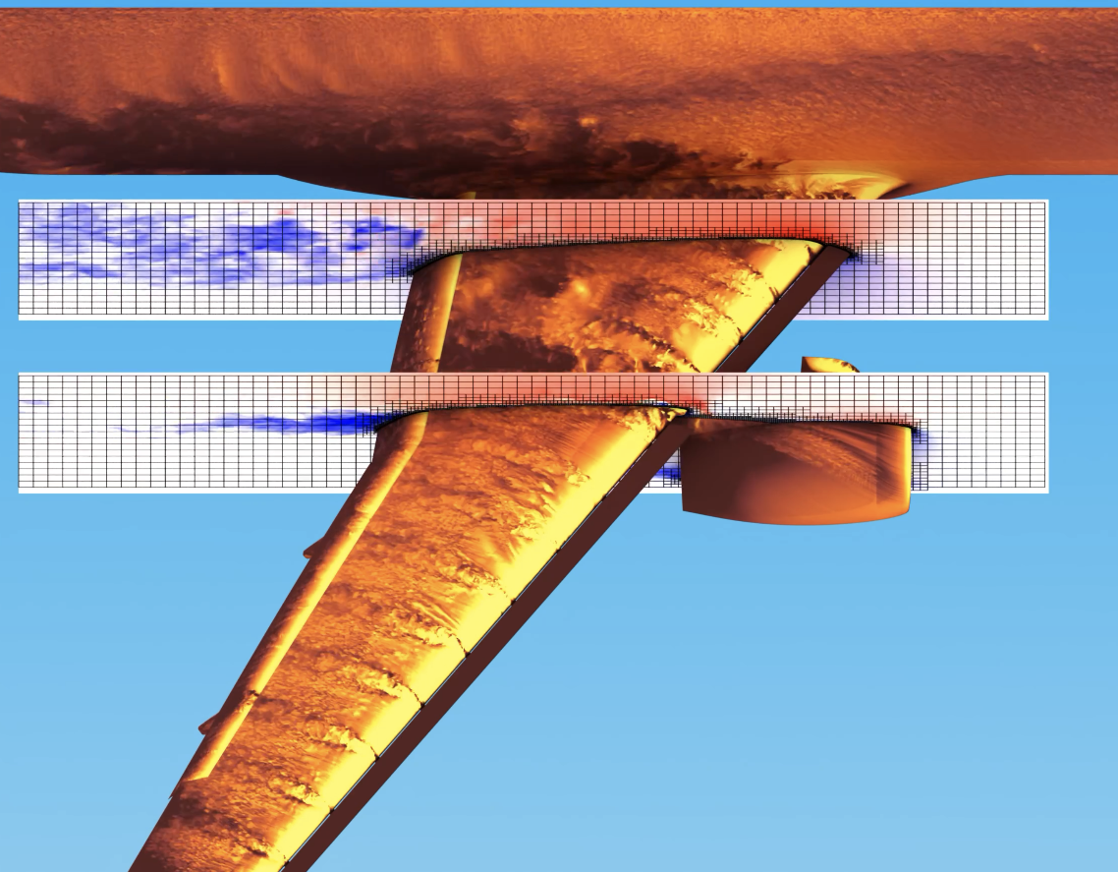
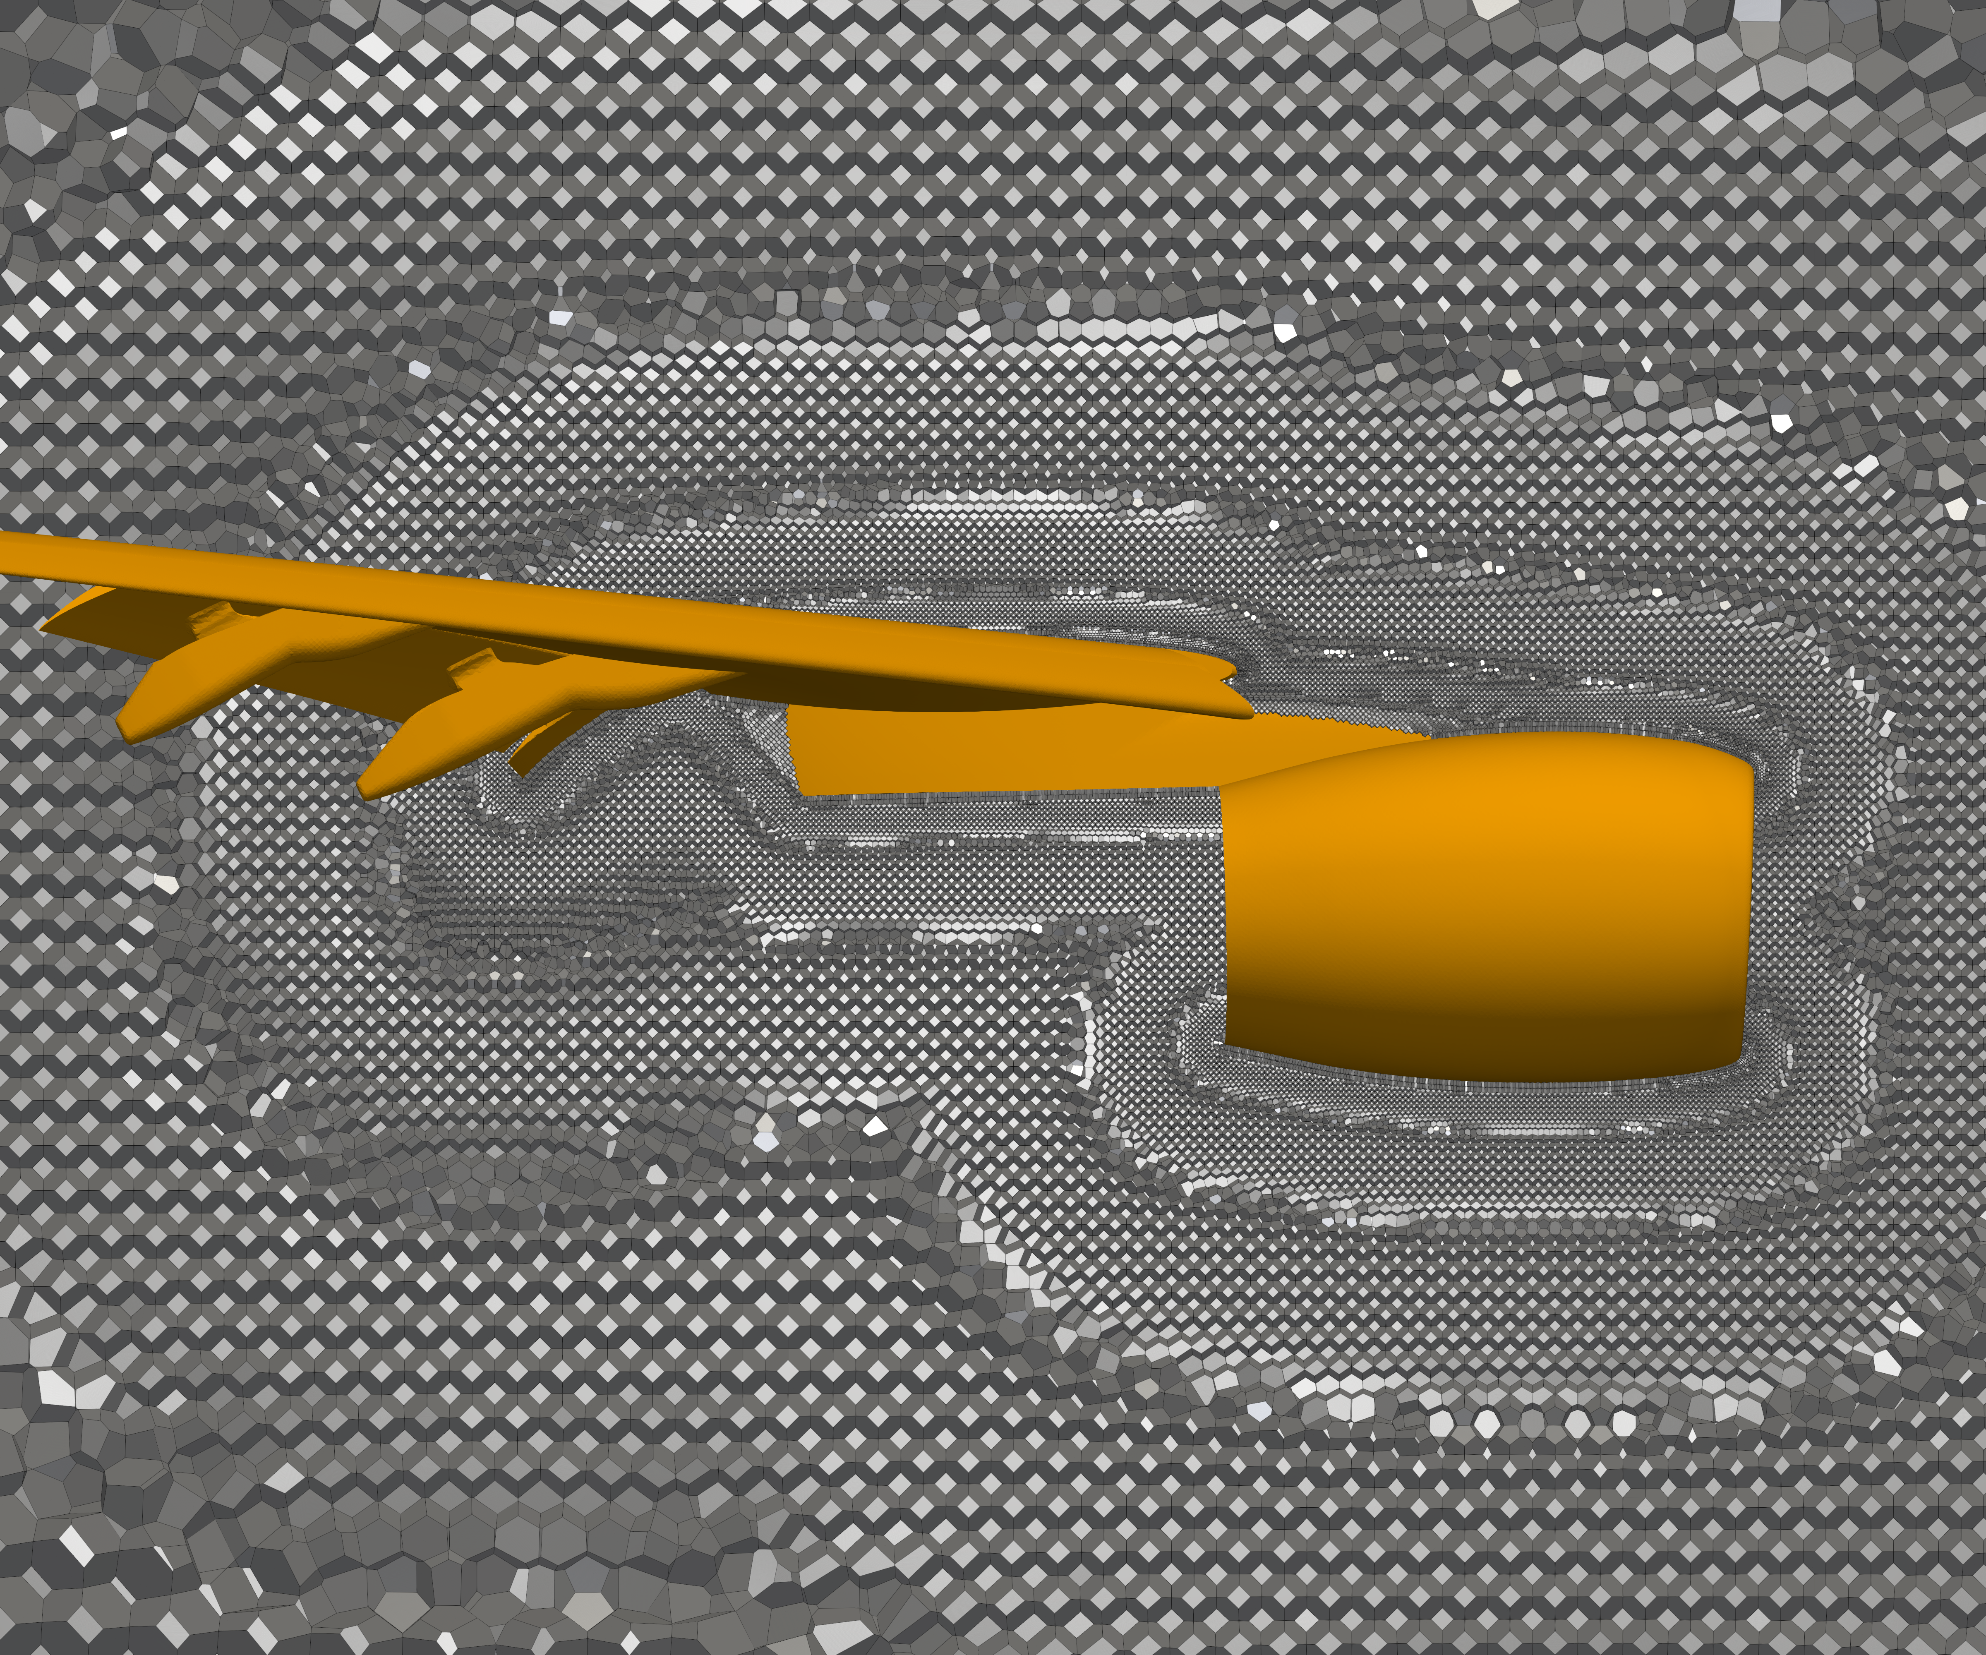
Launch, Ascent, and Vehicle Aerodynamics Framework
Structured Curvilinear | Cartesian | Unstructured Polyhedral
Largely manual grid generation | Automatic adaptive grid generation | Automatic grid generation
Low computational and memory cost | Low computational and memory cost | Higher computational and memory cost
Mature higher order methods | Mature higher order methods | Higher order methods less efficient and mature
Overset interpolation: not smooth | Factor of 2 refinements: not smooth | User prescribed mesh smoothness
Body-fitted | Immersed boundaries, non-body fitted | Body-fitted
WWW.NAS.NASA.GOV/LAVA/

Slide 3
Overset Gridding Pros/Cons
Scriptable/Reusable custom control of areas of physical import.
Body fitted grid with control of anisotropy anywhere.
Manual scripting (CGT, etc) can be time consuming, helped with well-organized best practices.
Automated methods (EPOGS), comparably limited in flexibility, manual growth corrections needed, still much faster.
The more weight we can take off the user’s shoulders, the better.

Slide 4
Overview
This talk overviews
what the LAVA Curvilinear Framework offers to
automate/simplify overset grid pre-processing
in a self-contained environment:
LAVA-CGT scripting framework
Block-to-blocks
Immersed boundaries
Connectivity
Panel weights
Refinement
Other Executables
(QOL tools / methodology)
(automated capture)
(forgo collar grids)
(fast, few-to-no manual cutters, MPI)
(automated calculation)
(fast, robust, ‘no’ alterations to scripts)
(generate, alter, interrogate grids/files)

Slide 5
Sections
LAVA-CGT scripting framework
Block-to-blocks
Immersed boundaries
Connectivity
Panel weights
Refinement
Other Executables

Slide 6
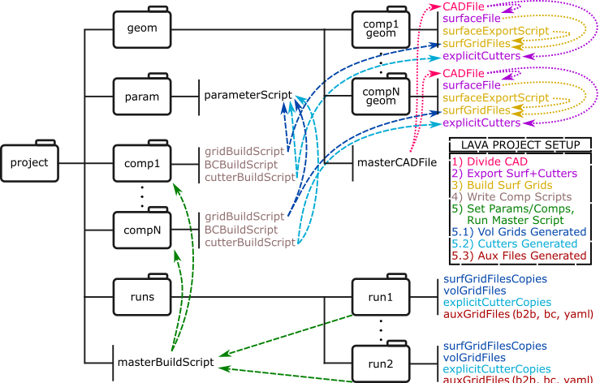
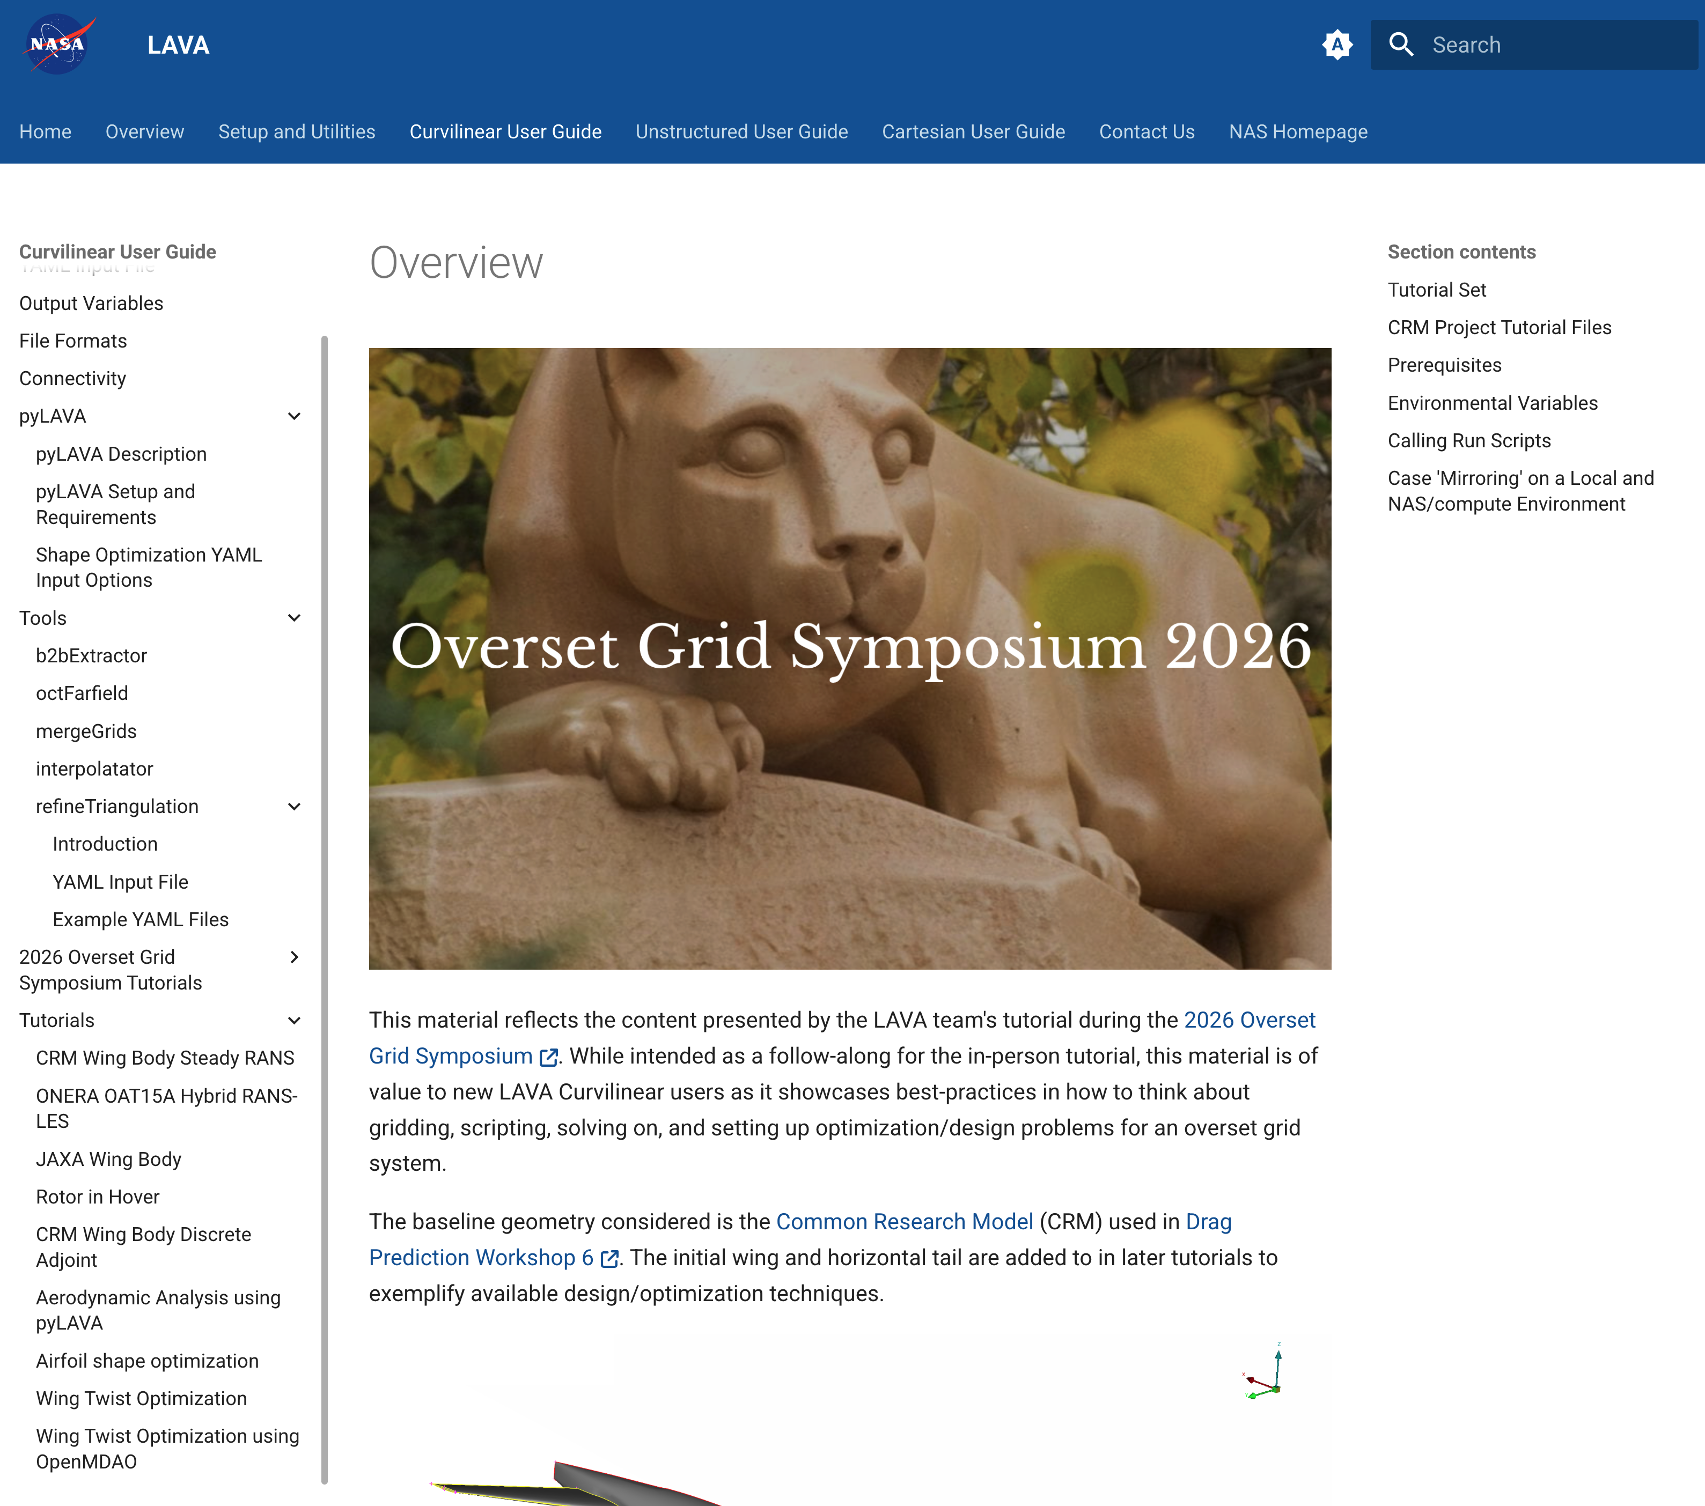
LAVA-CGT scripting framework
Component building: divide the load.
Pre-plan surfaces for easy refinement.
BCs scripted for LAVA use, including arbitrarily viscous block sides.
Easily pop new grids anywhere in scripts.
Easy to integrate/utilize EPOGS.
Discussed in depth in the LAVA OGS tutorial seminar.
WWW.NAS.NASA.GOV/LAVA/

Slide 7
Sections
LAVA-CGT scripting framework
Block-to-blocks
Immersed boundaries
Connectivity
Panel weights
Refinement
Other Executables

Slide 8
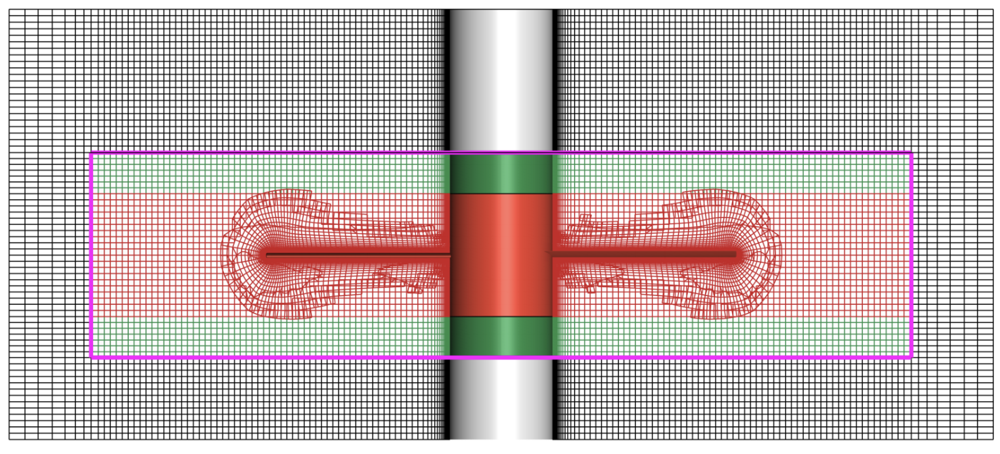
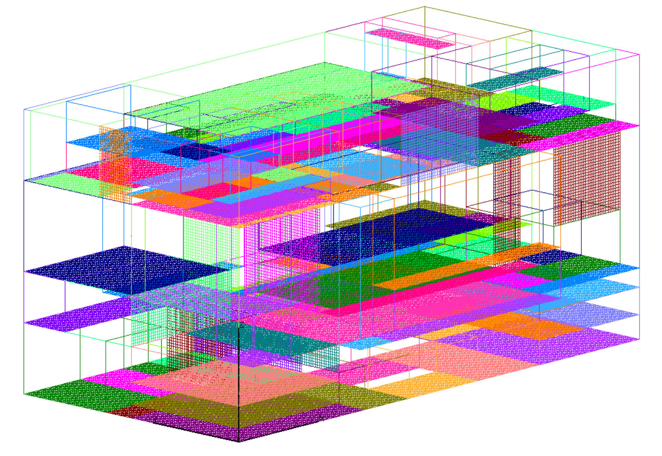
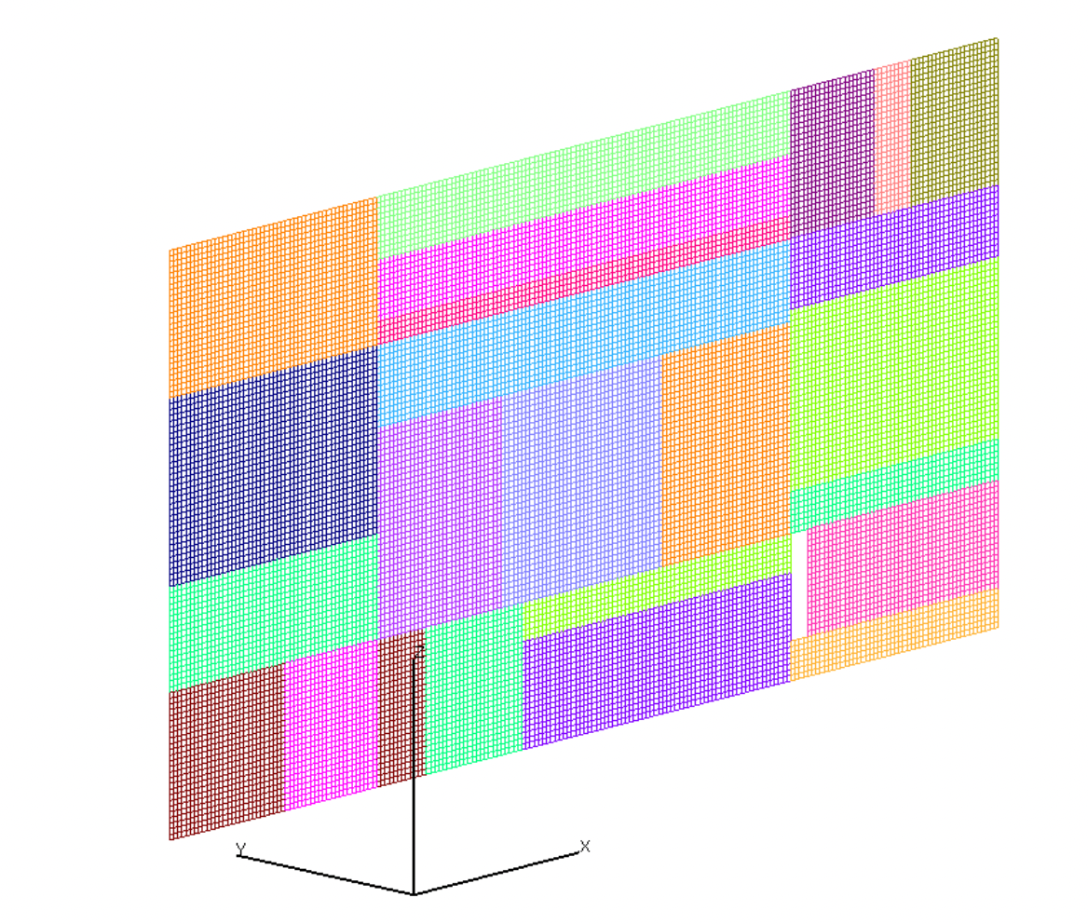
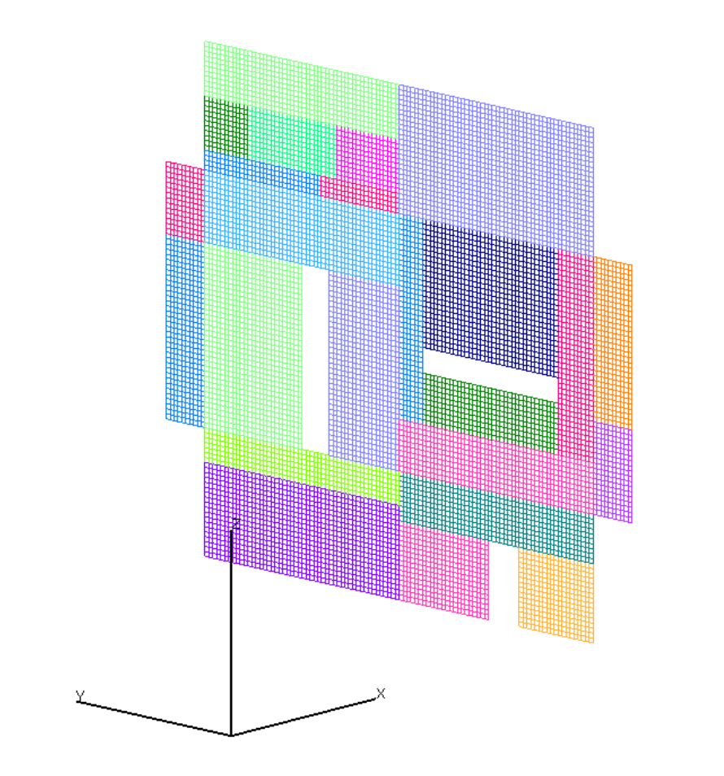
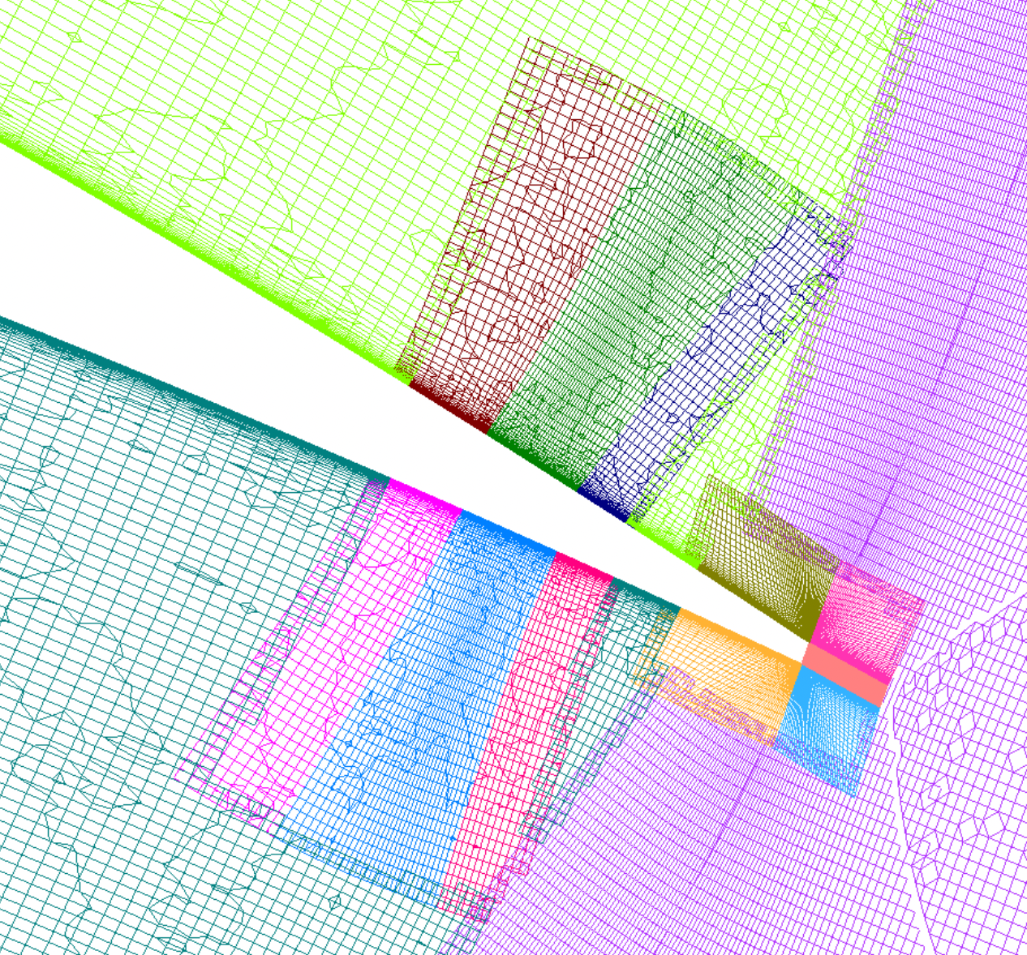
Block-to-Block (B2B) Functionality
Multiblock-structured / block-structured grids legal.
1:1 point matched B2Bs only.
Arbitrarily partial B2Bs legal.
Enables sliding meshes.
Good for trailing-edge wake-resolving.
Useful for LAVA’s refinement.

Slide 9
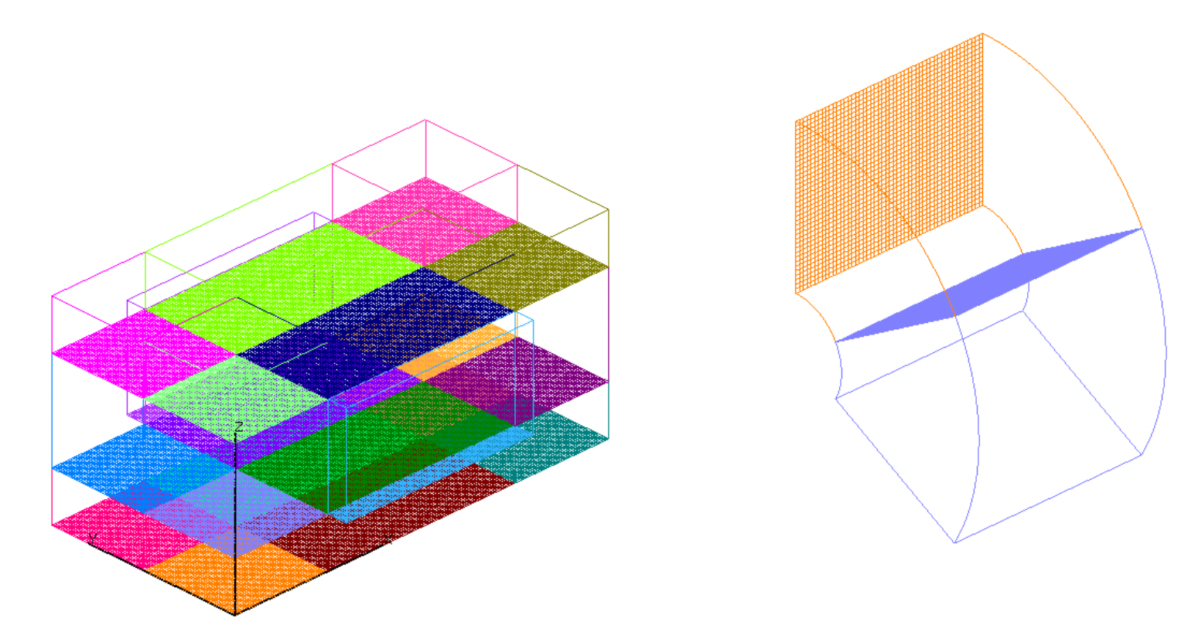
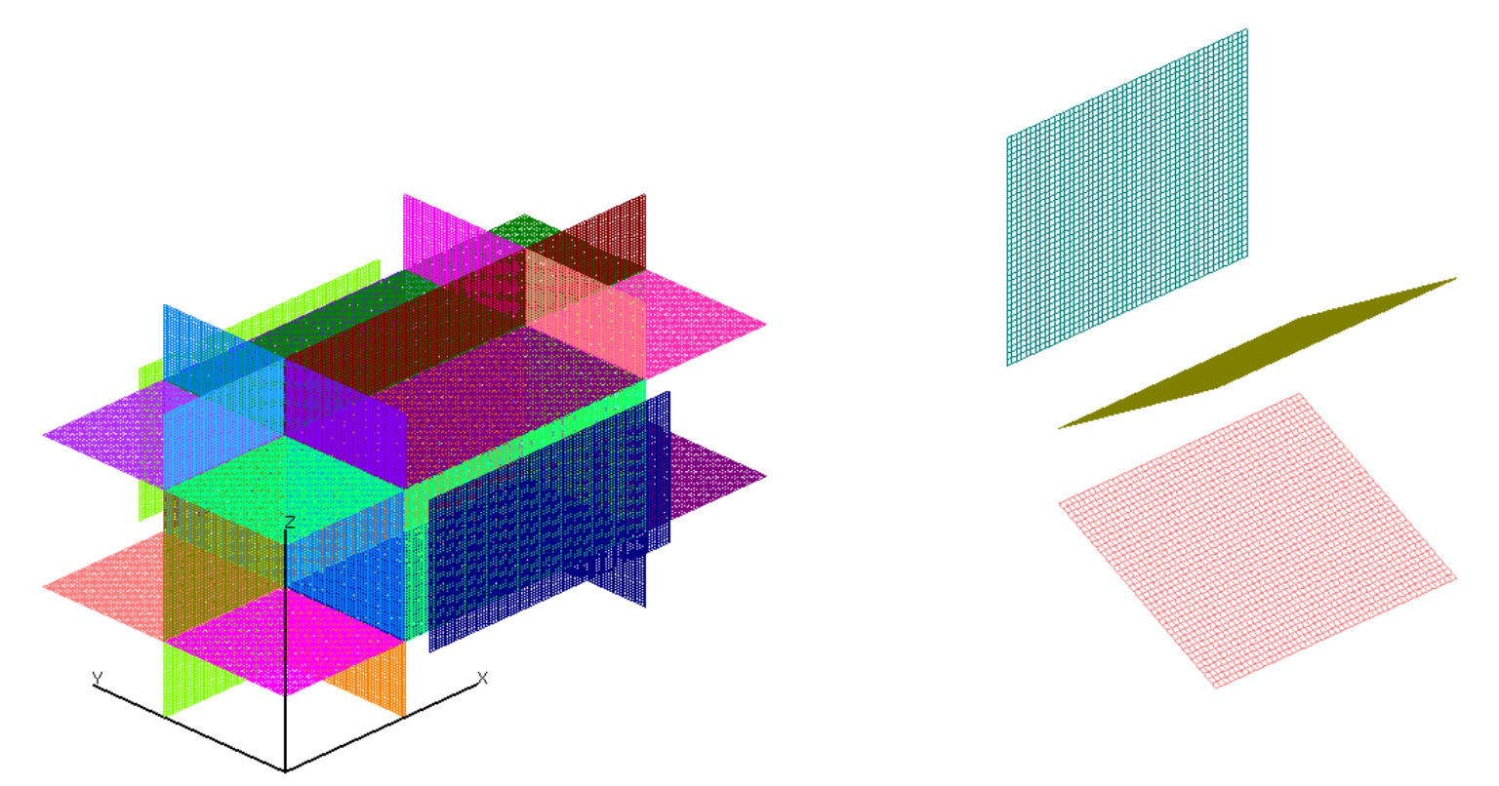
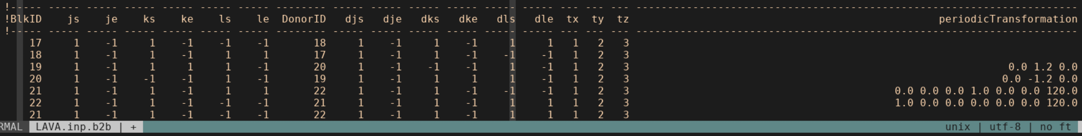
Block-to-Block Extraction Utility
Automatically find B2Bs in command line or at runtime.
Visually check for B2B errors.
Account for user-defined periodicity.
Warn or ignore ‘partial’ B2Bs.
Turn ‘off’ block sides.

Slide 10
Sections
LAVA-CGT scripting framework
Block-to-blocks
Immersed boundaries
Connectivity
Panel weights
Refinement
Other Executables

Slide 11
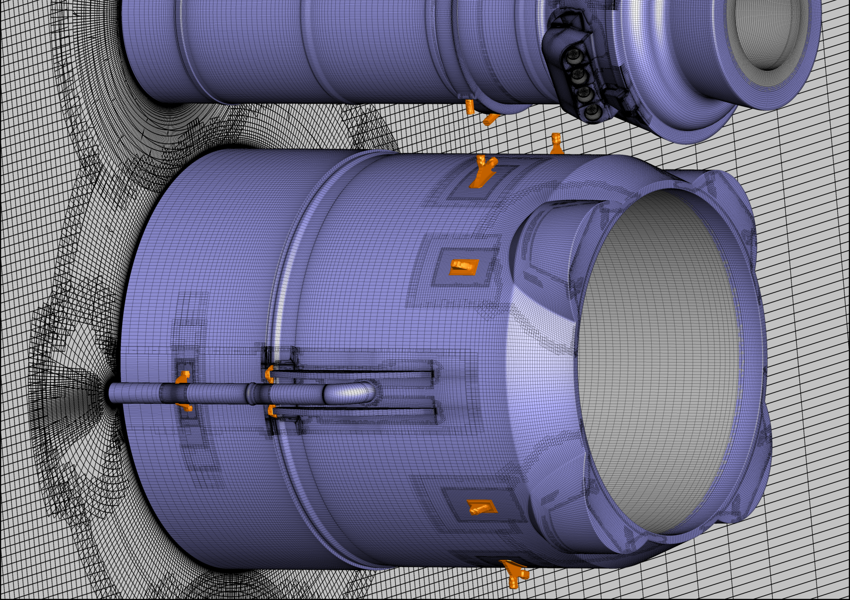
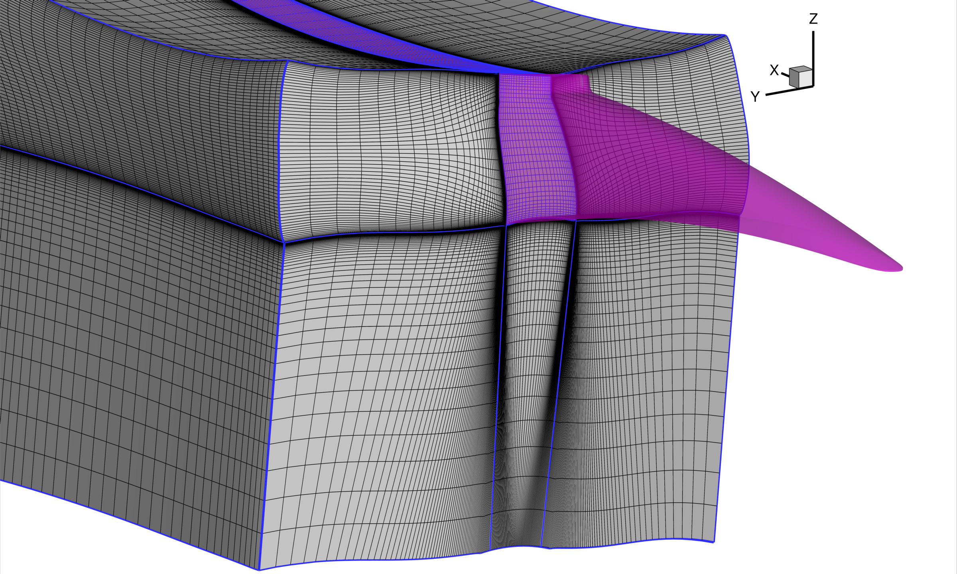
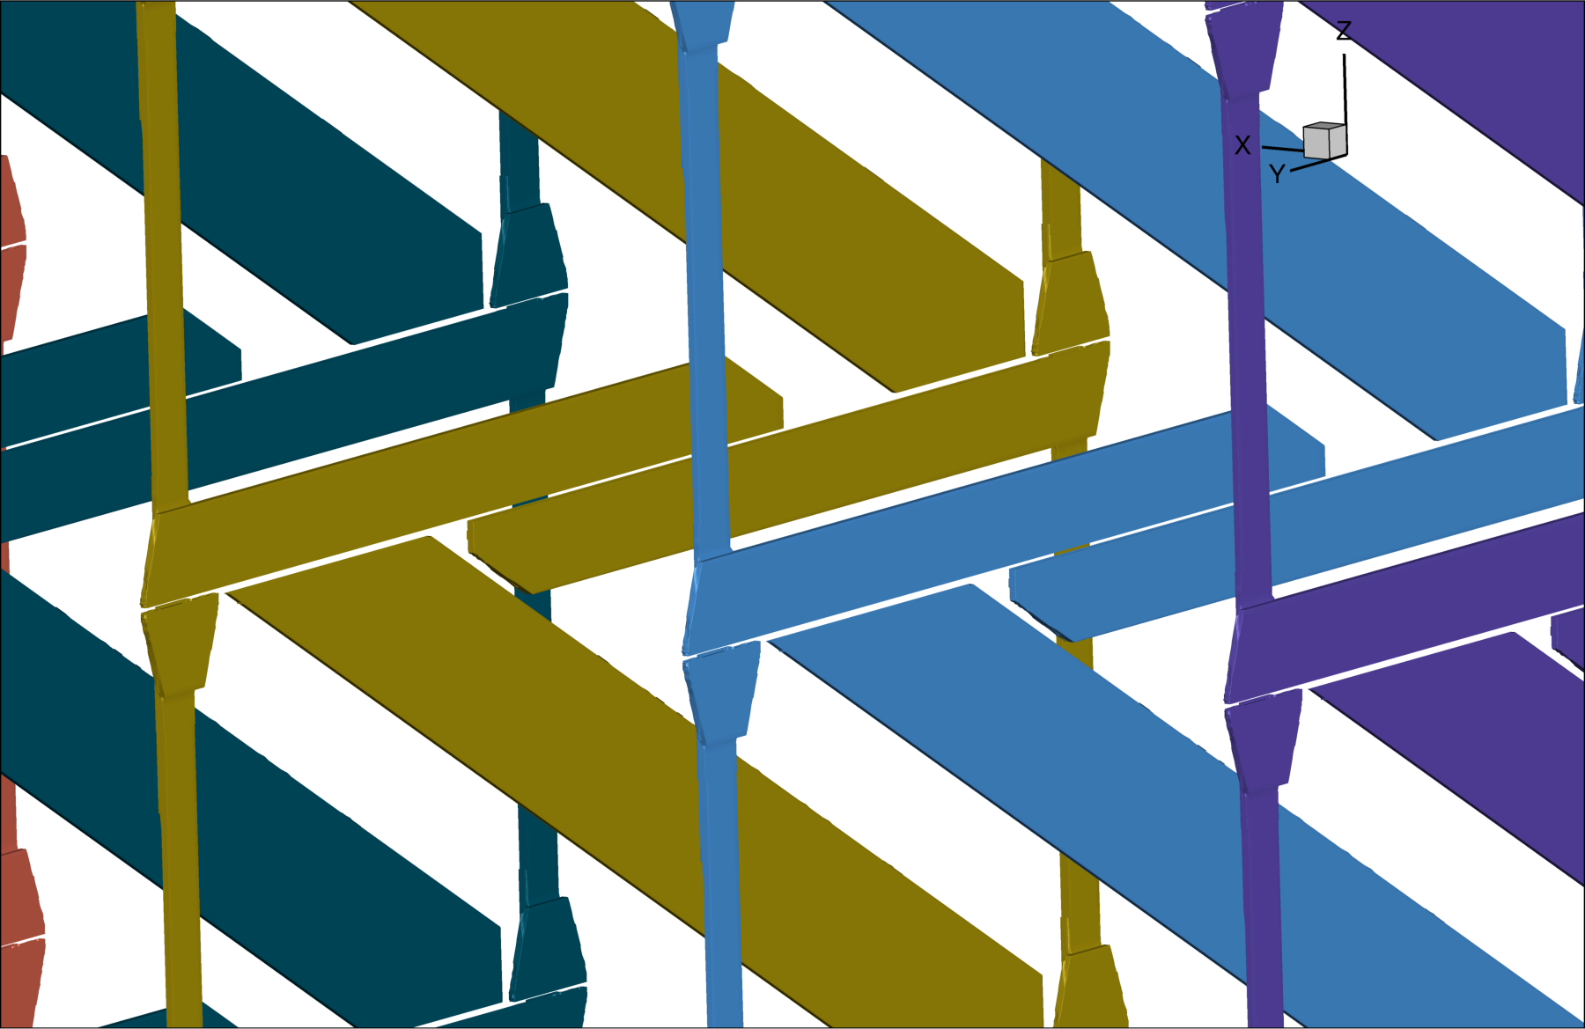
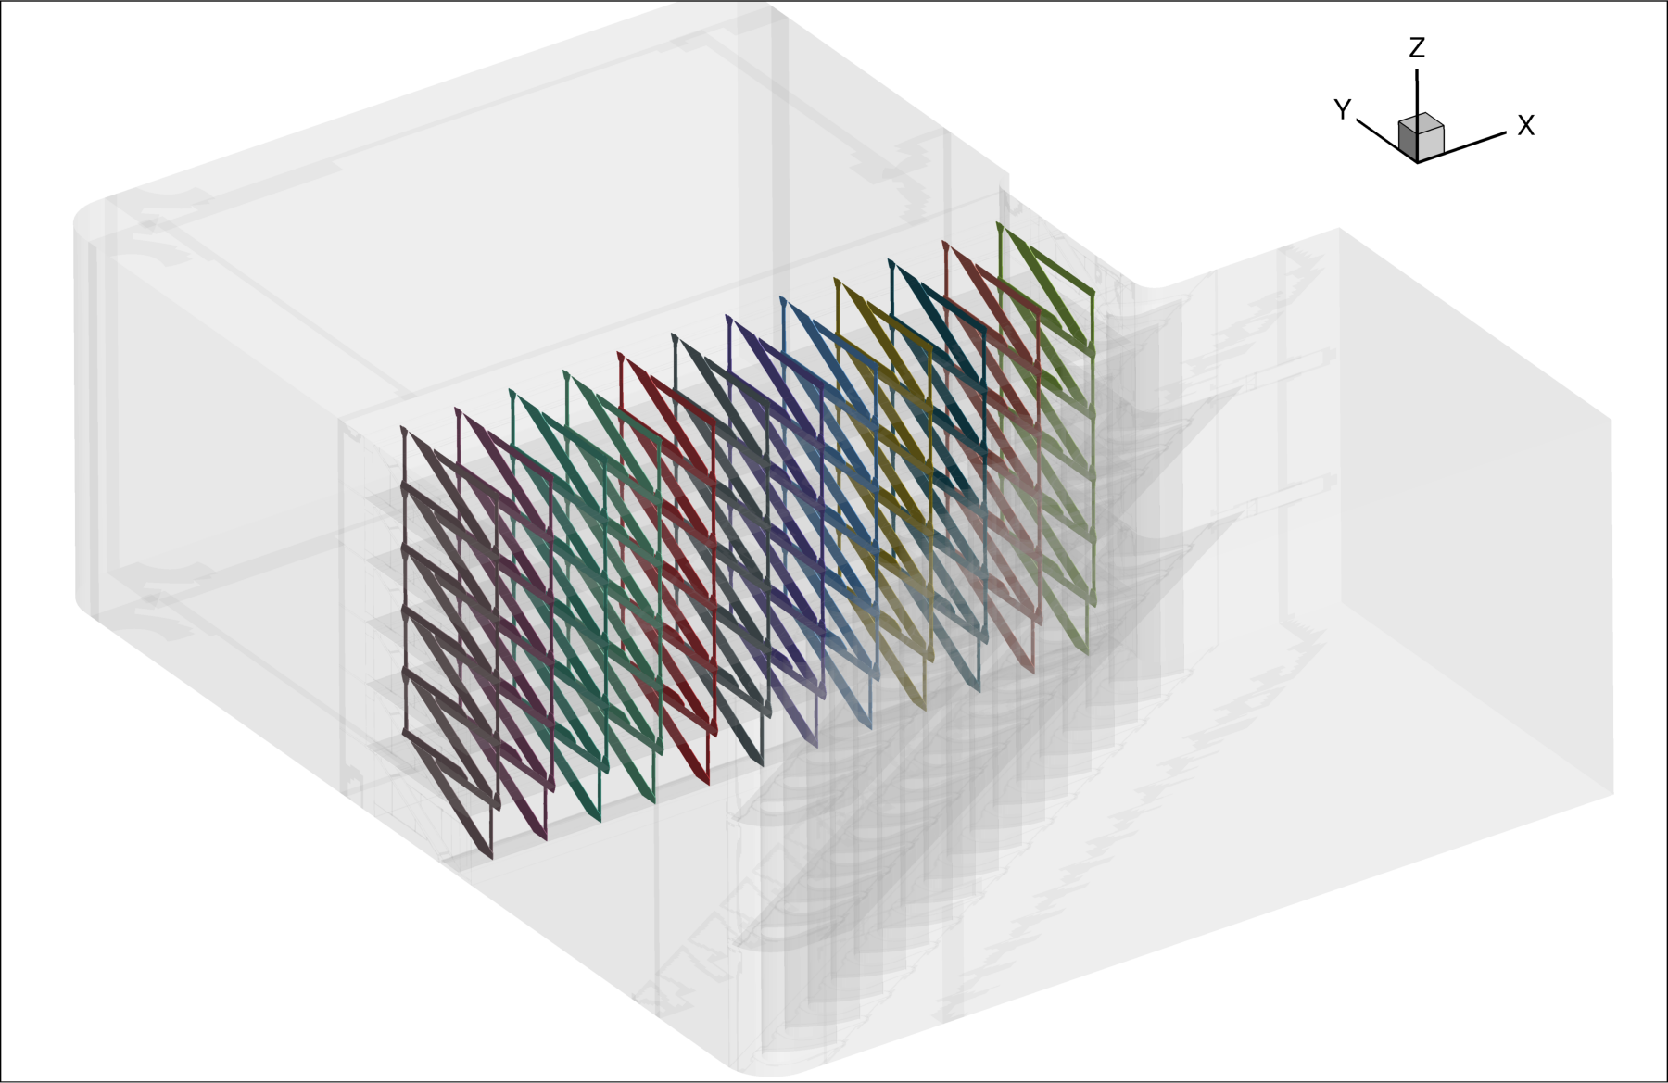
Immersed Boundary Handling
Nodes inside tri-surface tagged as immersed.
Penalty term applied during solution.
IB tag file written – only search once.
Uniform grid or body-conforming grids.
Tagging with offset distance.
Intersection with wall bodies ok.
Panel weights for integration.

Slide 12
Sections
LAVA-CGT scripting framework
Block-to-blocks
Immersed boundaries
Connectivity
Panel weights
Refinement
Other Executables

Slide 13
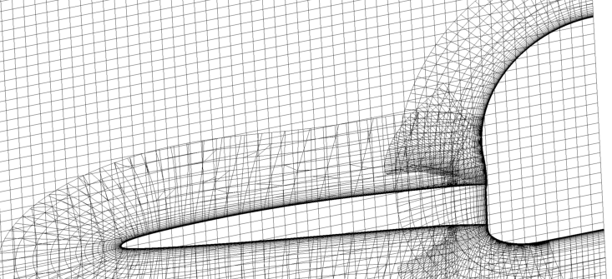
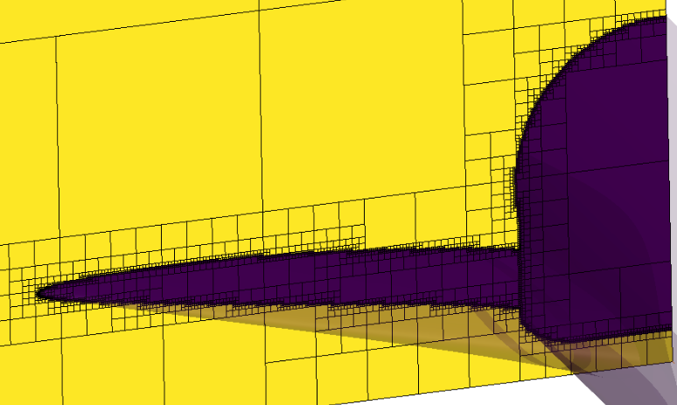
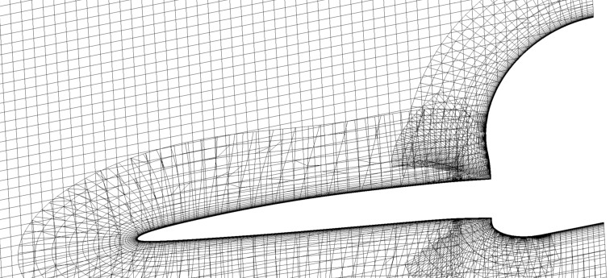
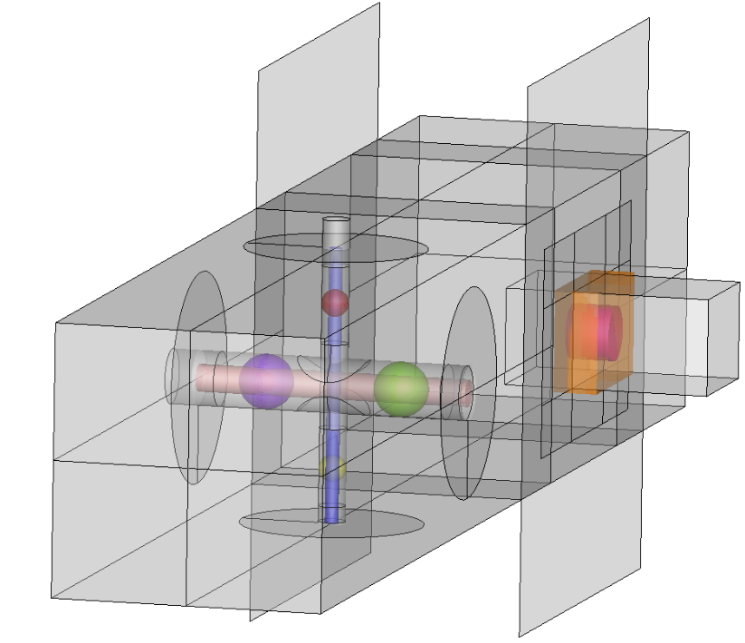
Connectivity Hole Cutting
Implicit: Defined Wall BCs cut grid via octree flooding, with option flood sources.
Explicit: User defined or geometric cut tri-surfaces with optional cut offset, and general clip planes.
None: keep existing (minimum or optimized, etc) hole cut if you know it’s already been computed.
‘Immersed-only’ zones immersed inside wall body.

Slide 14
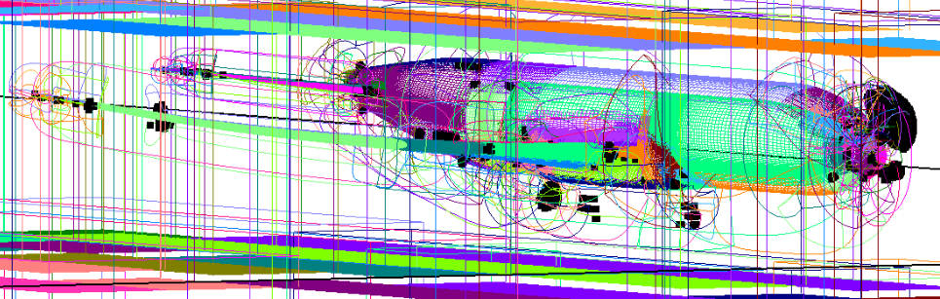
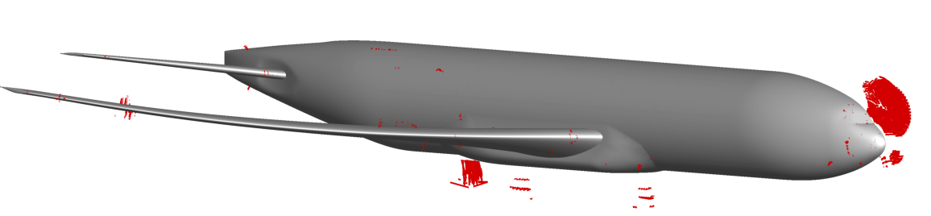
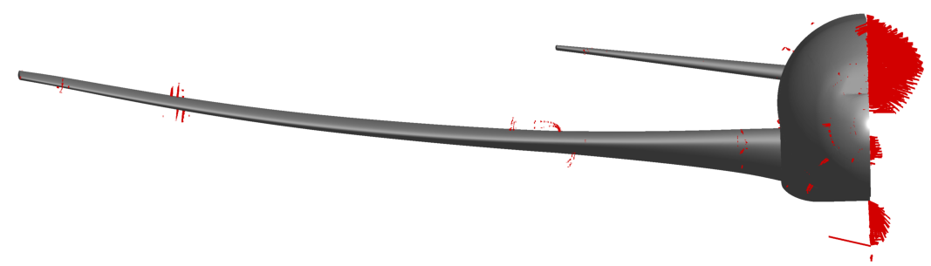
Connectivity Fringe/Orphan Donor Search
Non-BC/B2B block edge nodes find best donors.
DQUAL 1 enforced.
All nodes search for donor for later overlap optimization.
Orphans find the closest off-block face projection.
XINTOUT files from OVERFLOW must be re-computed with LAVA connectivity to ensure proper DQUAL and orphan treatment.
LAVA INTOUT files can be used with OVERFLOW.

Slide 15
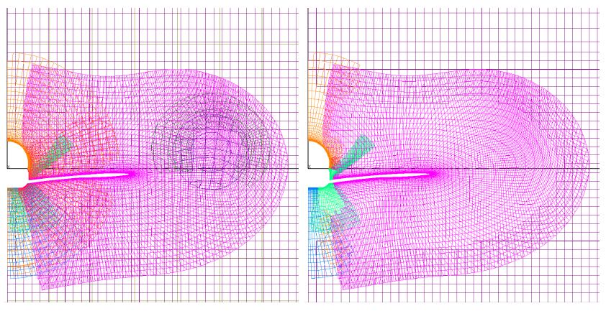
Connectivity Overlap Optimization
Grids removed if better quality grids overlap them.
Helps reduce required computational effort.
Orphan donor search performed after overlap removed.
User-specified by-zone priorities available to tweak grid overlap.

Slide 16

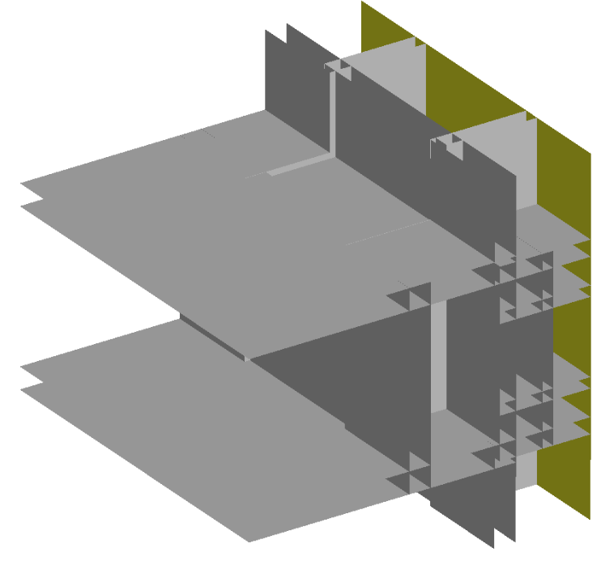
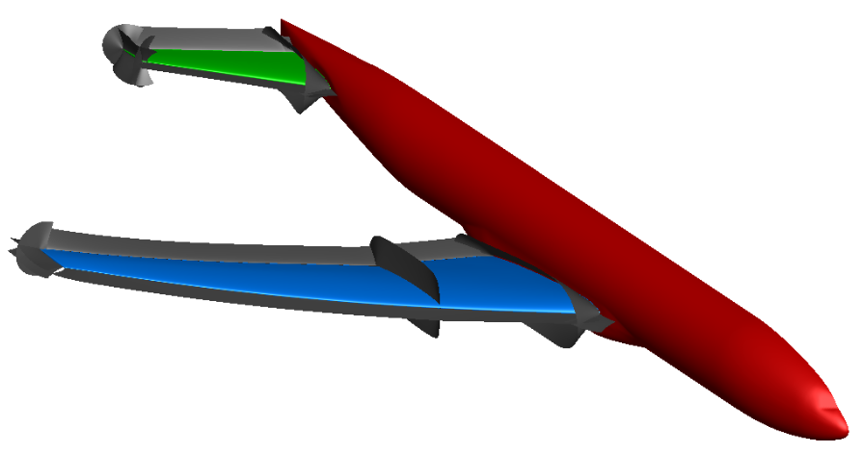

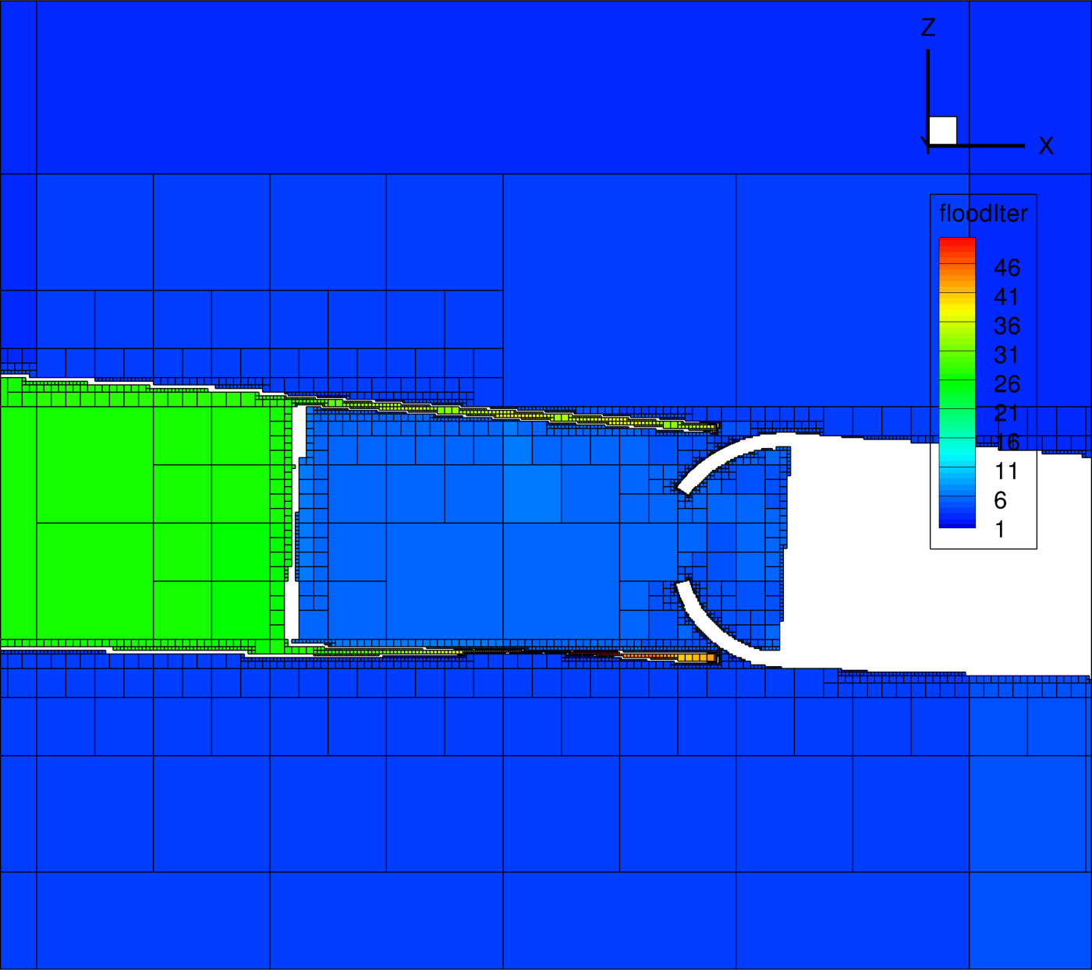
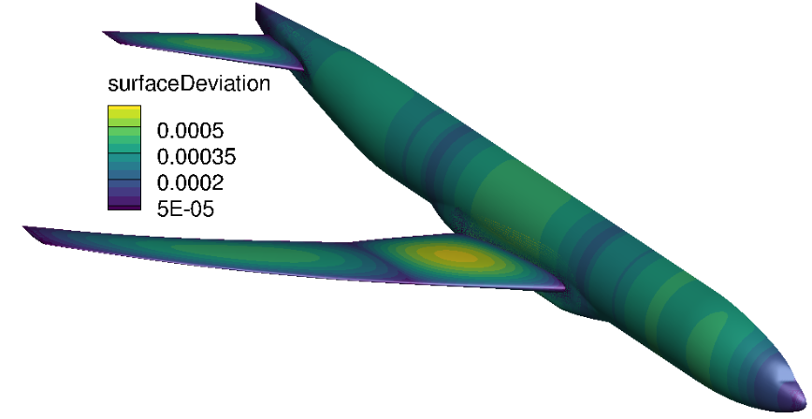
Connectivity Assessment / Debugging
Optionally written visual check files:
  Name-grouped BCs.
  Distance-banded orphan donors.
  Surface deviation and projection info.
  Octree flood iterations data.
Debugging dials:
  Manual provided on the LAVA site.
  Debug node output.
  Local flooding oct-tree refinement.
  Un-blankable enforcement.
  Surface projection tolerances.
Post-hole-cut file grid write checkpointing.

Slide 17
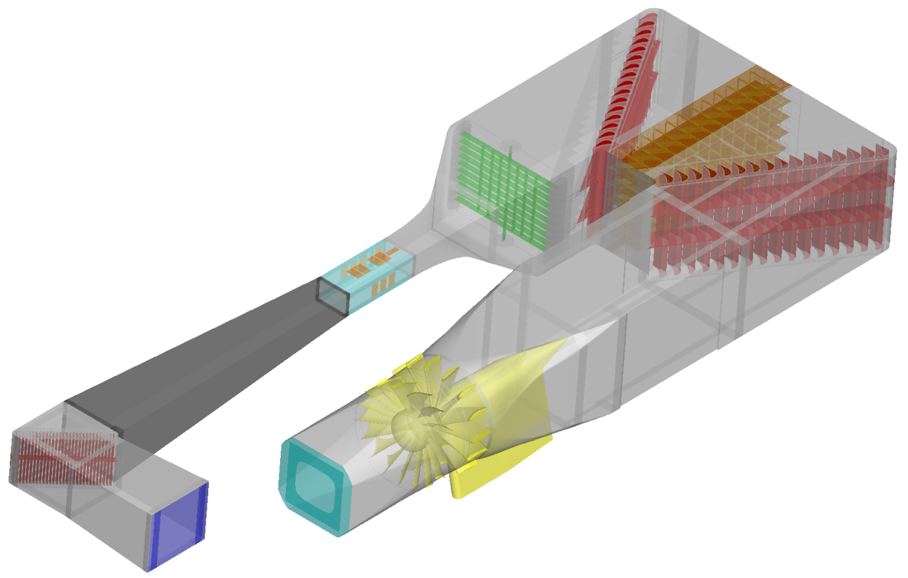
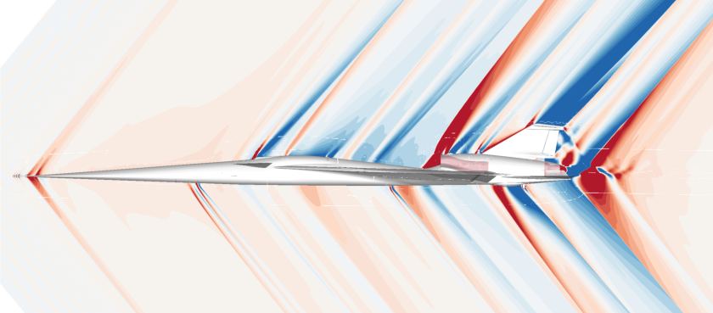
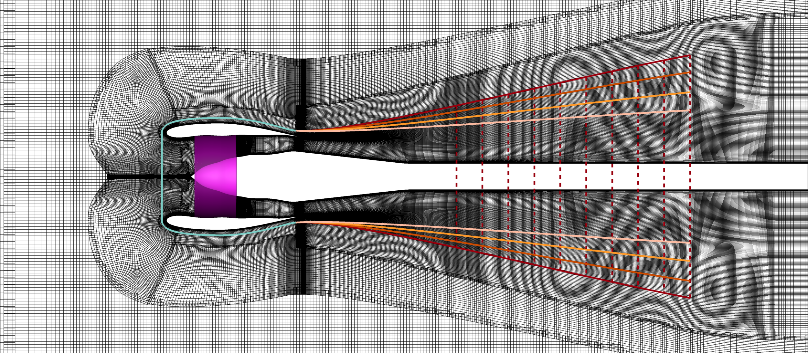
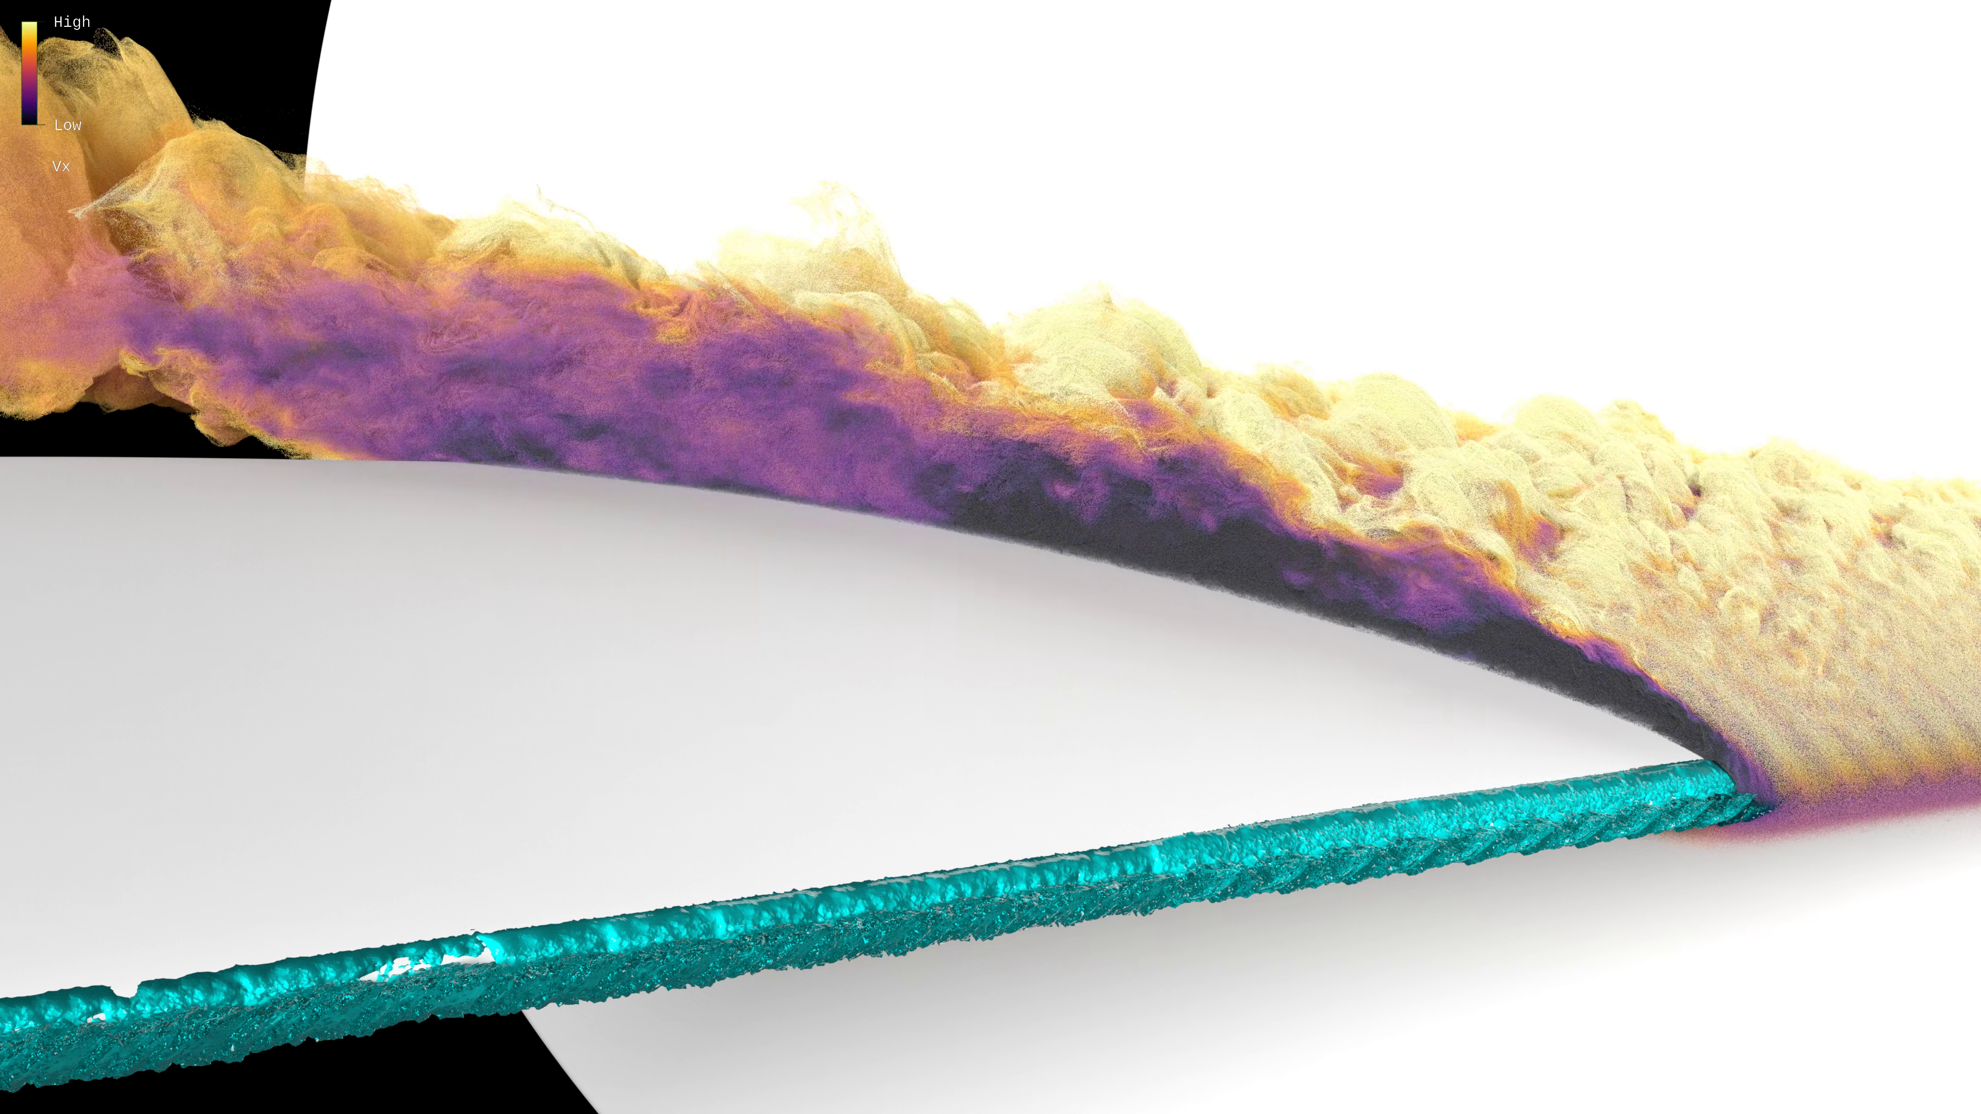
Connectivity
MPI-enabled in case need to re-compute during simulation
(e.g. re-computation of connectivity during X-59 design optimization).
Serial Timings (includes B2B extraction, connectivity, and panel weight generation):
Case | N Grids | N Nodes [Mil] | Threads | Time [min]
X-59 | 774 | 360 | 72 | 5.87
R4 | 627 | 1127 | 128 | 16.78
CRM Immersed Ice | 186 | 609 | 80 | 2.85
IRT | 1615 | 795 | 125 | 22.4
Generally |  | <300 | ~50 | 0-2
X-59
R4
CRM Ice
IRT

Slide 18
Sections
LAVA-CGT scripting framework
Block-to-blocks
Immersed boundaries
Connectivity
Panel weights
Refinement
Other Executables

Slide 19
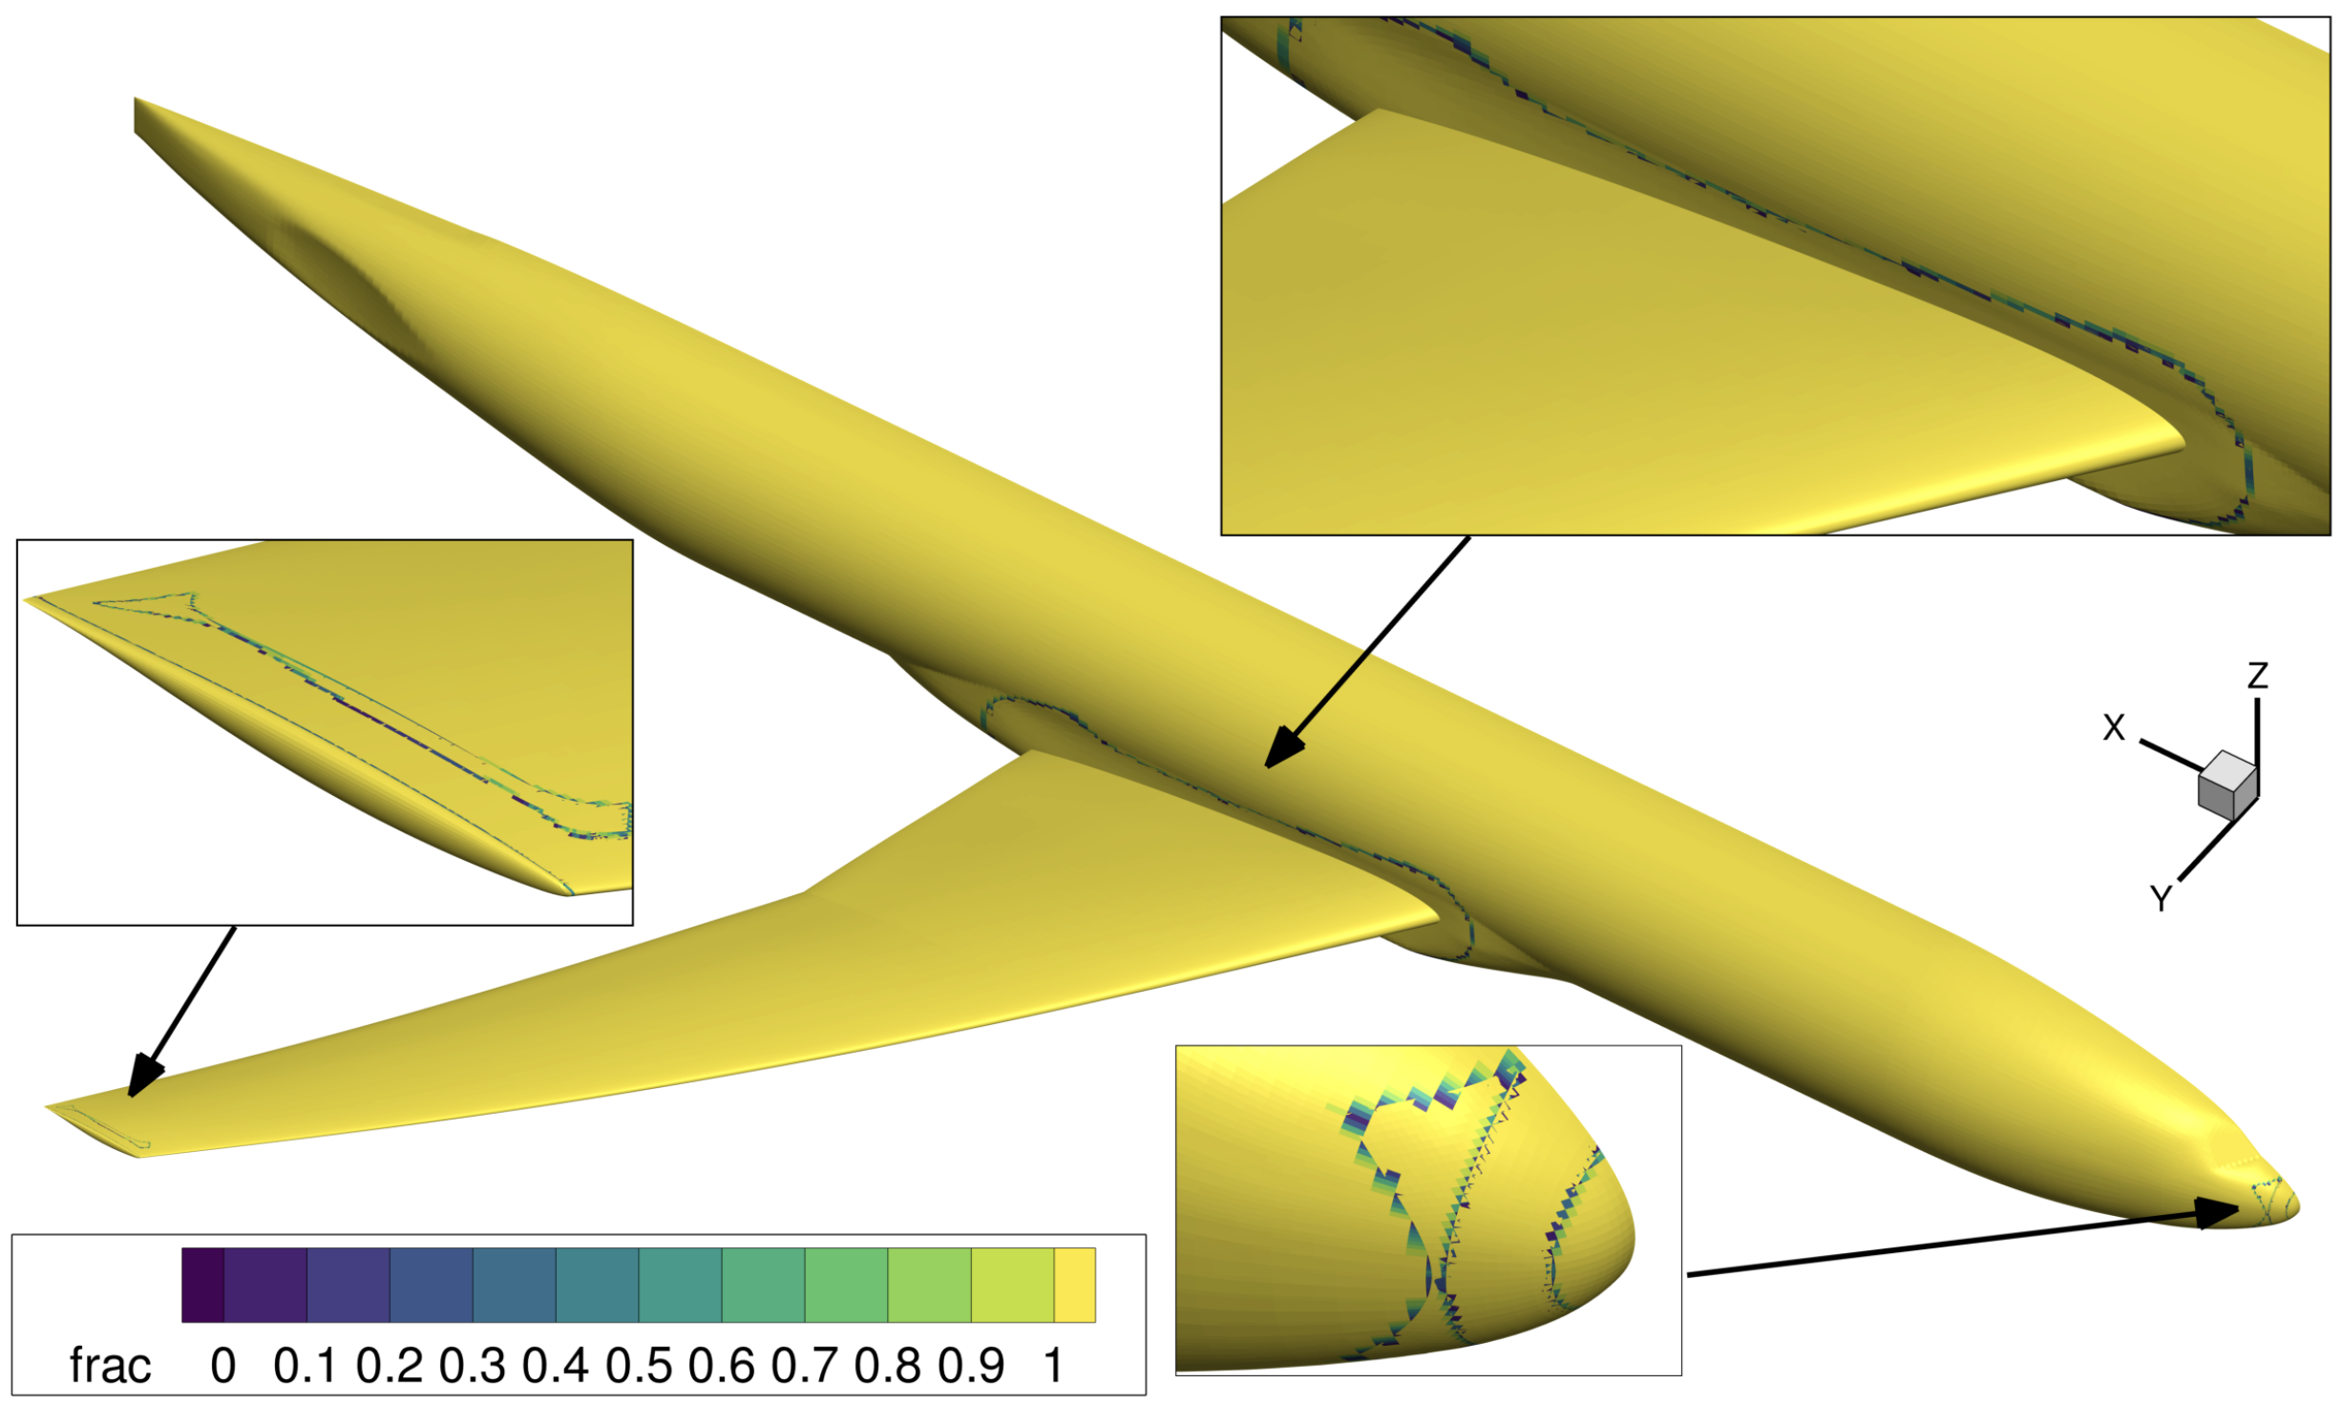
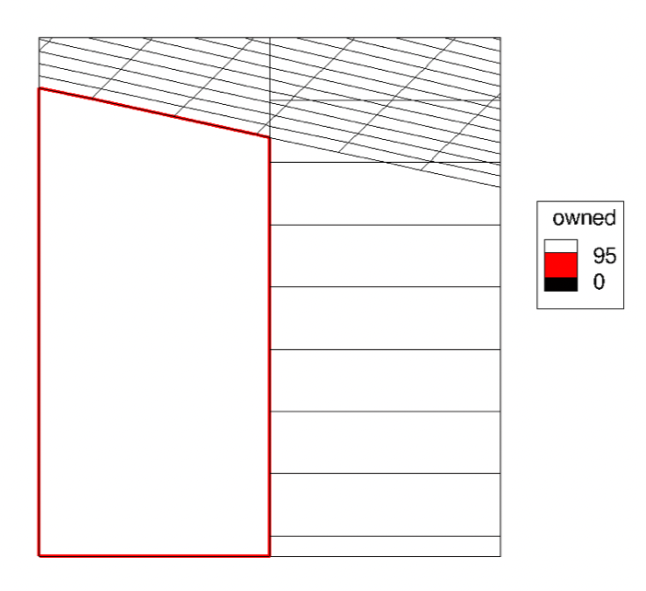
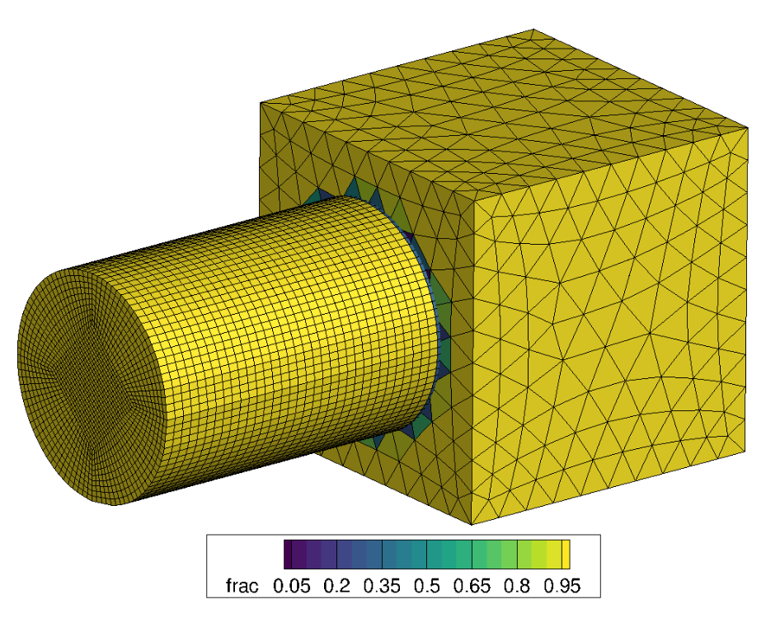
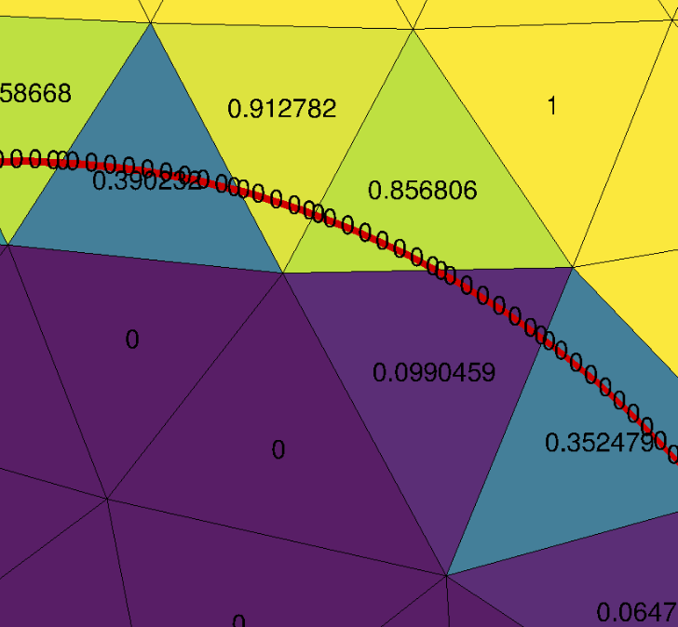
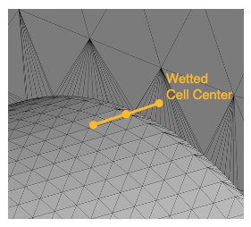
Panel Weights Using LAVA’s Overlapper Tool
Projects and cuts overlapped surface cells to find fraction of unit area accounted for.
Both wall BCs and IB surfaces allowed.
Intersections of wall/IB surfaces accounted for.
Wetted cell centers adjusted at intersections.

Slide 20
Sections
LAVA-CGT scripting framework
Block-to-blocks
Immersed boundaries
Connectivity
Panel weights
Refinement
Other Executables

Slide 21
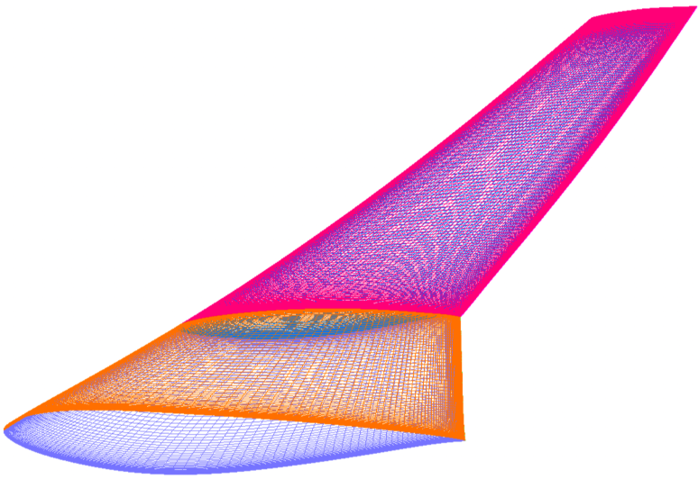
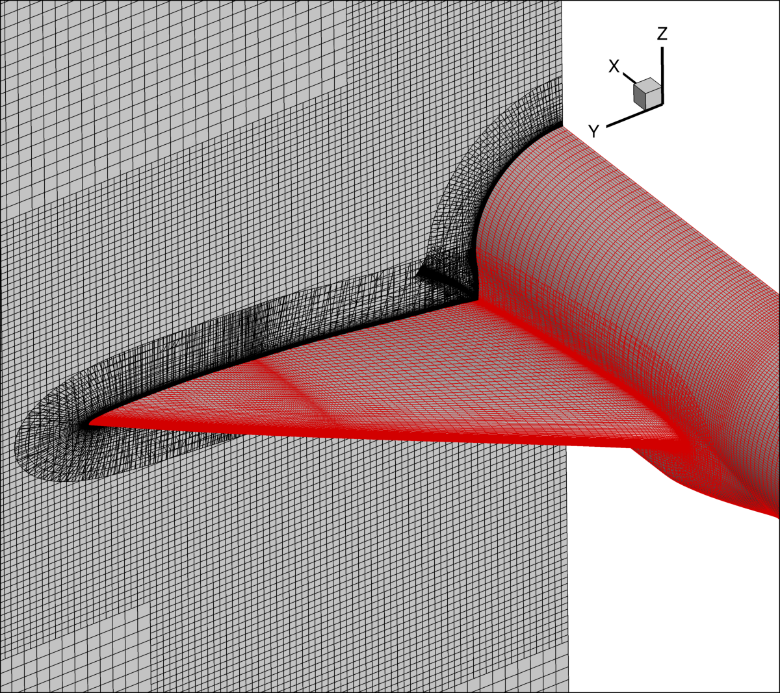
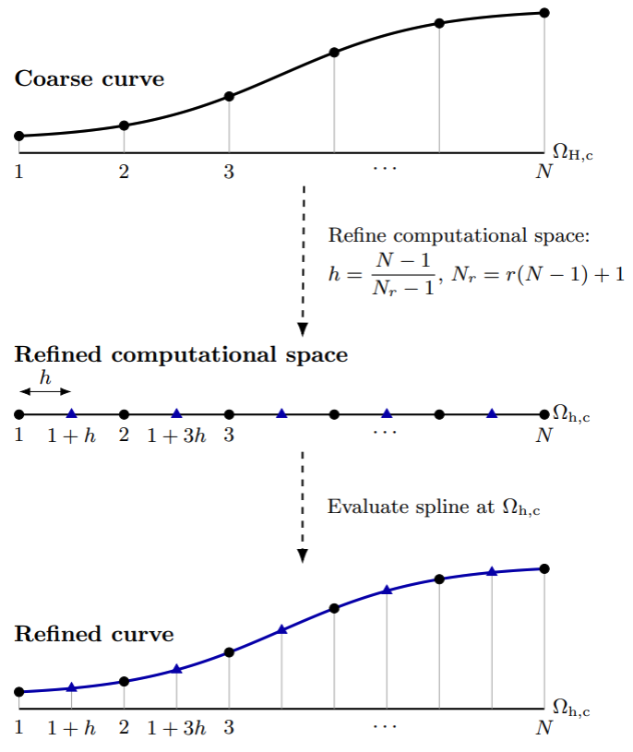
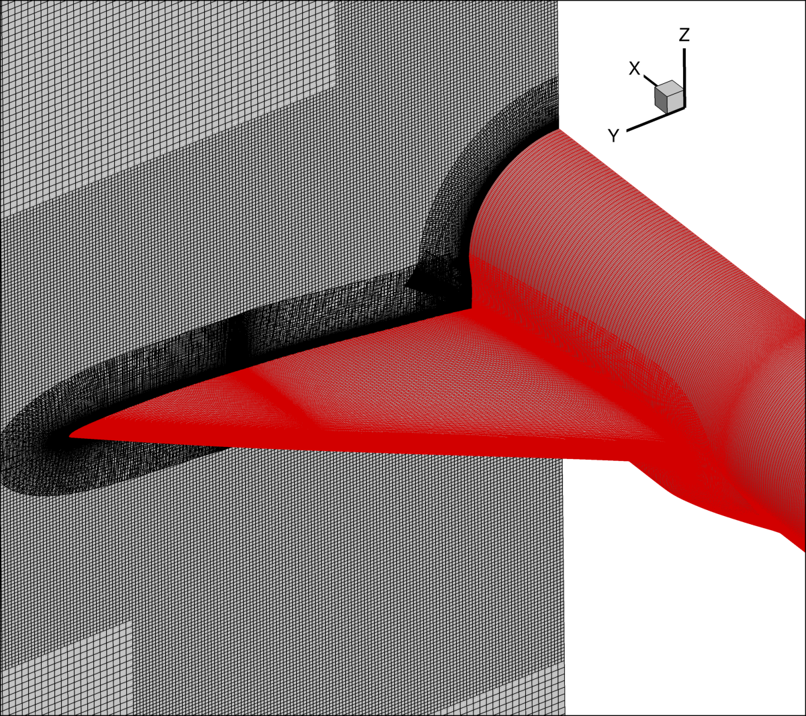
Spline-and-Refine Executable
Parameterizes each block curve, refines in curvilinear space, projects back to physical.
Requires blocks start/end at feature lines (B2Bs allow this well).
Block-specific refinement options, including directional refinement.
Can be used to coarsen (but overlap no longer guaranteed).
L 1.0
L 2.0

Slide 22
Sections
LAVA-CGT scripting framework
Block-to-blocks
Immersed boundaries
Connectivity
Panel weights
Refinement
Other Executables

Slide 23
Other Pre/Post-Processing Executables
cgns_to_lava -------------------------
quadTriProjTrim -----------------------------
octFarfield -------------------
mergeGrids ---------------------
compareINTOUT ----------------------------------------------
checkInput -------------------------------------
verifyTriangulation --------------------------------
refineTriangulation ----------------------------------
postInterpolator -------------------------------
Write a plot3D grid and bc file from a CGNS file.
Project quad grid onto tri and blank if can’t.
Make a Cartesian octree far field using nearbody tri file.
Combine N grids, BCs, and B2Bs (e.g. near/far field).
Are two hole cuts the same?
Is my input yaml ok before I submit a run?
Is my tri file (EHCs or immersed) bad?
Fix under-resolved immersed loads.
Interpolate a solution onto a different grid.

Slide 24
Upcoming Features
Dynamic Connectivity.
Aspect-ratio, solution-alignment, and immersed distance priorities.
Refined re-distribution for residual reduction.
Surface triangulation auto-quadding.
Azimuthally non-uniform sliding mesh wedges for multi-stage turbomachinery analysis.
Dynamic Aeroelasticity superposition modal setup.

Slide 25
Acknowledgements
This work was primarily supported by the Research Technology Mission Directorate (RTMD) Integrated Methods and Research (IMR) Project (previously TTT), with additional support provided by the High-Speed Flight (HSF) and Subsonic Vehicle Technologies (SVT) Projects and their predecessors.
Computational resources supporting this work were provided by the NASA High-End Computing (HEC) Program through the NASA Advanced Supercomputing (NAS) Division at Ames Research Center.
The exceptional contributions of the LAVA team are acknowledged.

Slide 26


